Slide 1





YOLO WORLD
Real-Time Open Vocabulary Object Detection
Peng Lu
Unibo LM informatica 2025/2026

Slide 2

TABLE OF CONTENTS
Chapter 1 : Introduction and model architecture
Chapter 2 : Chapter 2 : Discussion about process of experiment
Chapter 3 : Experiment and result

Slide 3

CHAPTER 1 : INTRODUCTION
WHAT IS YOLO-WORLD 1
YOLO-World, an innovative approach that enhances YOLO with open? vocabulary detection capabilities through vision-language modeling and pre-training on large-scale datasets.
Original YOLO(You only look once) is a closed dataset, which is very efficient on the object they have seen.

Slide 4
CHAPTER 1 : INTRODUCTION
WHAT IS YOLO-WORLD 2
YOLO-World: Real-Time Open-Vocabulary Object Detection.
  Object detection: locate and classify object.
  Open-vocabulary: user-provided text prompts at inference time.(Even train sample doesn’t have it)
  Real-Time: Quick on the speed

Slide 5

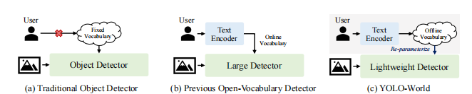
CHAPTER 1 : INTRODUCTION
CLOSED VOCABULARY
OPEN VOCABULARY
  Efficient
  But limited on categories(Only accept the categories trained)
  Input an image then return the bounding box of fixed categories.
  text models with image models
  Can predict unseen object by using test embedding with visual features.
  But previous open vocabulary are huge and slow.

Slide 6
CHAPTER 1 : INTRODUCTION
WHAT CHANGES MADE BY YOLO WORLD WITH PREVIOUS OPEN VOCABULARY?
Old open vocabulary (Online vocabulary):
Every times detect object in an image, it process image and text embedding at same time, try to blend the text features with image features during process (Every layers, calculate the relation between image pixel with text vectors ).
YOLO-World (Offline vocabulary):
Launch the text encoder first compute the prompt to the text embedding, then bake them into the model's weights at convolution layer (Re-parameterization) , and text encoder is not used anymore. Every image feature arrive to last step, have just need to interact with the pre-calculate text weight to get the final result.

Slide 7
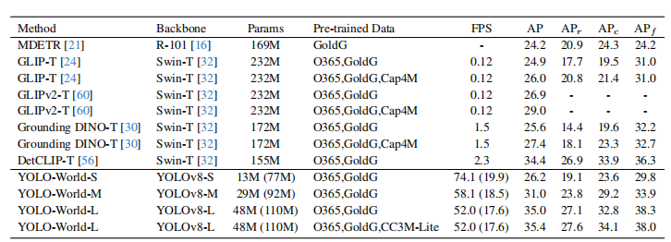
CHAPTER 1 : INTRODUCTION
FPS is frame per second what model processed.
YOLO-World model is much faster than other open vocabulary models.

Slide 8
CHAPTER 1 : MODEL ARCHITECTURE
Text encoder of YOLO-World:
  A pretrained model of CLIP
Image encoder of YOLO-World:
  YOLOv8 backbone network (When an image is fed into it, it extracts multi-scale visual features )
RepVL-PAN (Re-parameterizable Vision-Language Path Aggregation Network): The bridge between two encoders, as mentioned before, with this network text encoder is able to compute text vector first and baked into the visual layer and disconnect the text encoder.

Slide 9
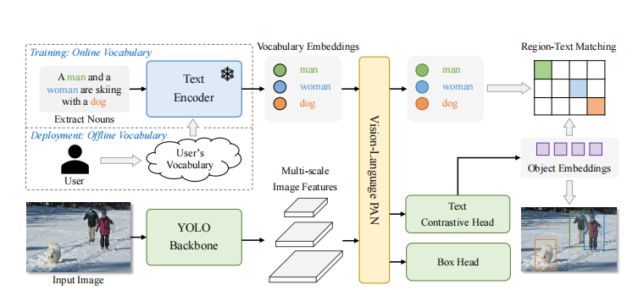
CHAPTER 1 : MODEL ARCHITECTURE

Slide 10
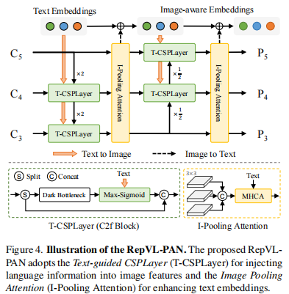


CHAPTER 1 : MODEL ARCHITECTURE INSIDE THE REP-VL PAN AT TRAIN PHASE
P stand for the features pyramid, C stand for multi-scale image features.
Following two component are used to enhance the interaction between the image features with text features:
Text-guided CSPLayer (cross-stage partial layers) : This highlight the part of image more matches with text embedding.
Image-Pooling Attention (I-Pooling Attention):
It pool the image feature from high numbers of token into N tokens, then fusion with text embedding to generate the vision language feature.
W → Text embedding, after reparametrization become a constant value.
X → image features

Slide 11
CHAPTER 1 : MODEL ARCHITECTURE PRETRAIN
YOLO-World use the pre-train methods called as: Region-Text Contrastive Learning
A mechanism called Region-Text Pairs, which associate bounding box with the text, and with amount of data to train.
The data comes from different sources:
  Standard Detection Data: Like object365 (365 categories)
  Grounding Data Datasets: Like GQA and Flickr30k where phrases in text are mapped to boxes in images.
  Pseudo-Labeled Image-Text Data: Extract the nouns from images with a text parser, then using an ai model to guess which part of image does this text correspond.

Slide 12
CHAPTER 2 : DISCUSSION ABOUT PROCESS OF EXPERIMENT
What experiment will be realized in this project?
FINE TUNING
But different as paper described, instead of re-implement the experiment introduced in the paper.( fine tuning on different yolo world with different version of model and compare with zero shot version and different yolo models, it too heave to evaluate.)
The aim of project is try to fine tune a small version of YOLO-World with a specific small dataset and compare it with the zero-shot version to see the differences.

Slide 13
CONTINUATION OF CHAPTER 2
TWO DIFFERENT WAY TO FINE TUNE THE YOLO-WORLD
  Fine tune YOLO-World with a closed-set( multi modal dataset), after fine tuning, yolo world lost its generality, act as the normal YOLO models.
2. Fine tune YOLO-World with the Mixed Grounding Dataset (Open-Vocabulary), this keep its ability to understand random text prompts. (Need to pairs images with rich text descriptions or phrase-grounding annotations )

Slide 14


CONTINUATION OF CHAPTER 2
WHAT KIND OF FINE TUNING CHOSEN?
The first one is chosen, fine tuning with a multimodal dataset, this lost its generality, but get more accurate values at prediction. This makes the model become a closed-vocabulary model as the general YOLO models, but it is less costs respect the general YOLO models.
For its capability of zero shot( or open-vocabulary), when we need model to focus into a specific fields that model never seen before, the current can converge very quickly and have a good improvement even with the small sample of train. Just need 50-80 epochs to converge.
If we want let YOLO models to understand a new field, we need more epochs to let model understand.( requires more computational cost, because it can just learn from the image sharps)

Slide 15
CHAPTER 3 : EXPERITMENT AND RESULT
Aim: Fine tune the YOLO World
  zero-shot prediction vs fine tuning prediction
By compare the difference to discover the difference between prediction before pretrain and after fine tuning.

Slide 16
BACKGROUND
Model:
  yolov8s-worldv2 (smallest pretrained model of yolo world) offered by Ultralytics (Creator of YOLO).
Enviroments(Hardware):
  Kaggle notebook
  T4 GPU
  Image size: 640x640
Dataset:
  VisDrone (Images are drone footage, from Kaggle dataset)
  Why use this dataset, the pretrained model usually is trained by horizontal perspective images, VisDrone images are taken from high perspective.

Slide 17
PROCESS BEFORE FINE TUNING
Data process:
  Download/import dataset to Kaggle notebook
  Convert into YOLO format dataset(images and labels, this format is accepted by Ultralytics, with original YOLO World they accept the COCO format object. )
Fine tuning:
  Set model as the version of YOLO World predefined
  By description of YOLO World documentation about the fine tuning, the 80 epoch is enough.

Slide 18
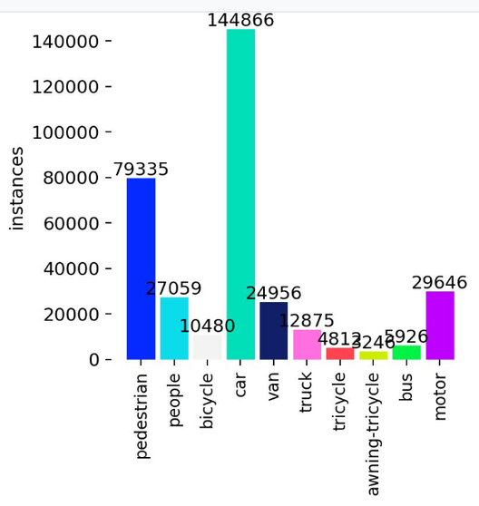
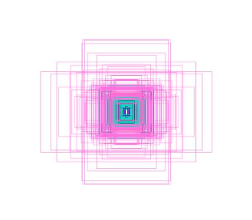
RESULT DURING TRAING

Slide 19
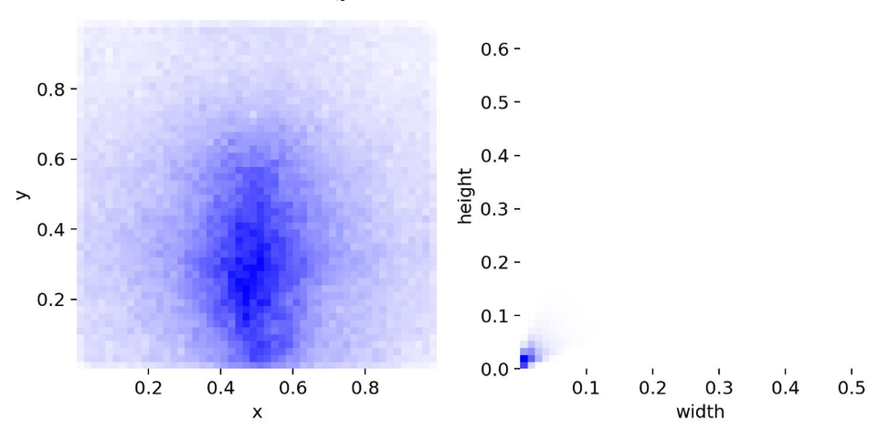
RESULT DURING TRAINING

Slide 20
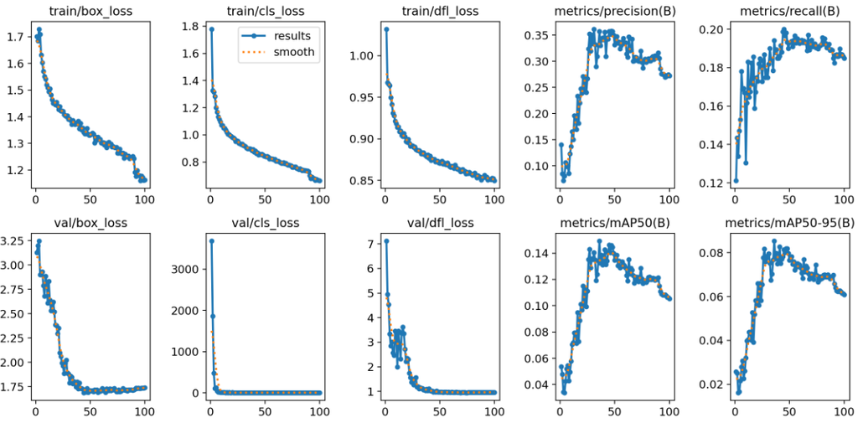

RESULT DURING TRAINING
  Performance peaks around epoch 45–50, then decline. ( Evaluate on mAP50 and mAP50-95)
  val/box_loss become plateau after epoch 50, so the best weight is settle between 45 and 50 epoches.

Slide 21
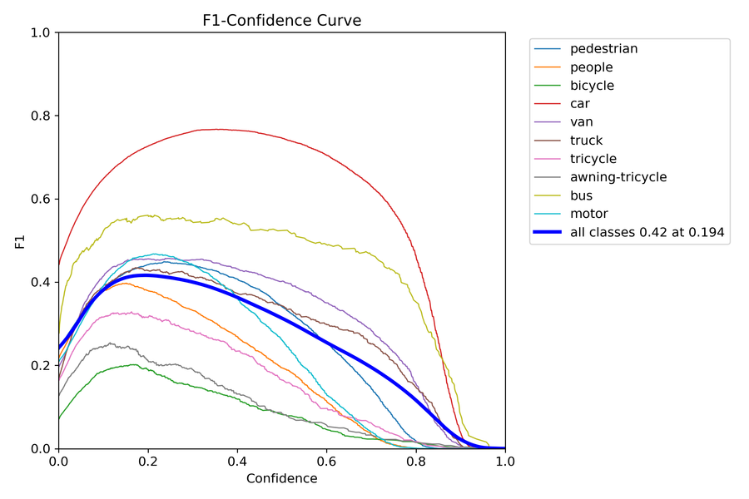
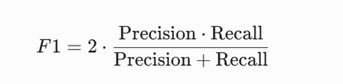
RESULT DURING TRAINING
Confidence: The probability threshold(c). Only prediction over c are considered true. Only those images surpass c are considered valid bounding box
The F1-score is the harmonic mean of Precision and Recall

Slide 22
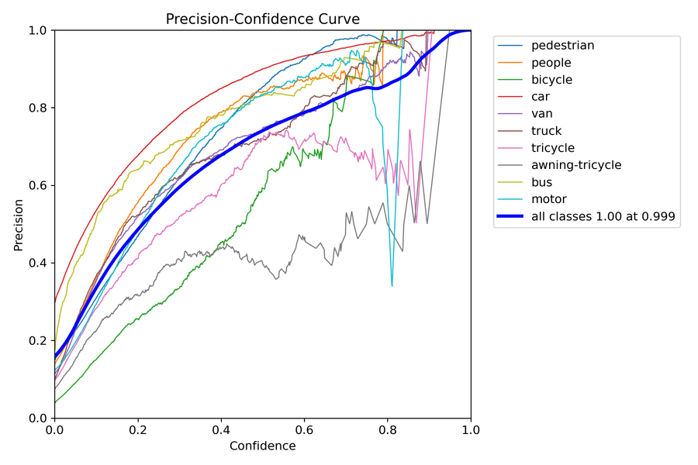
RESULT DURING TRAINING

Slide 23
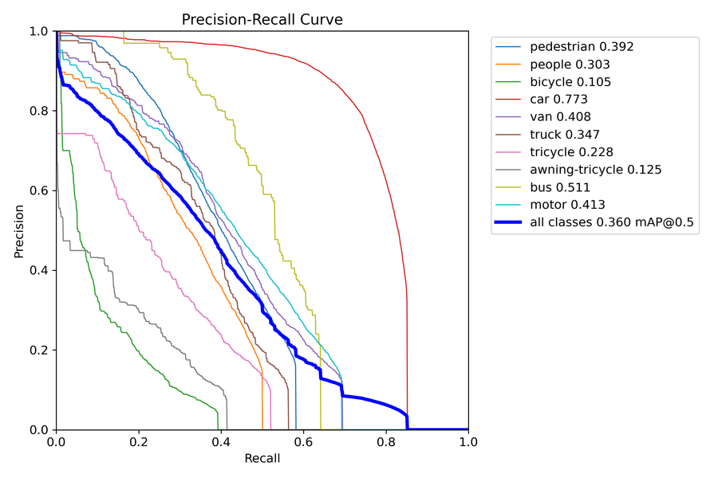
RESULT DURING TRAINING

Slide 24
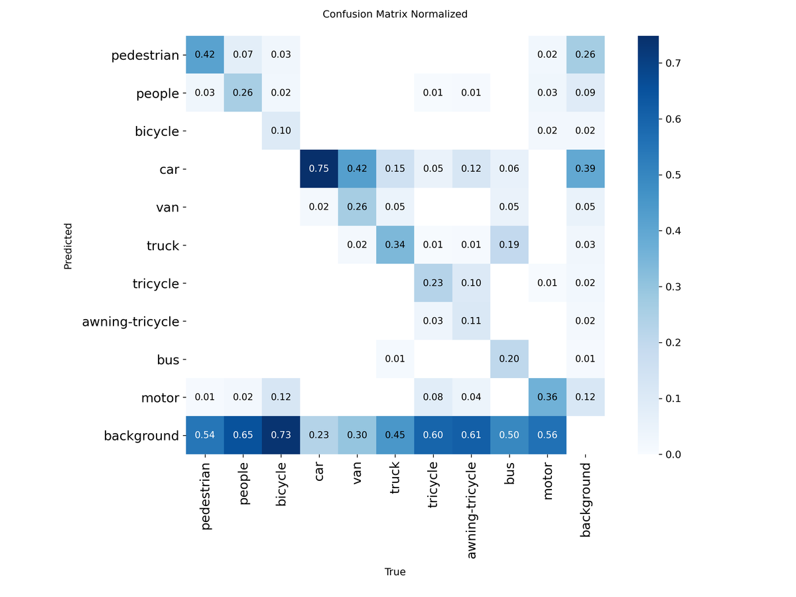
RESULT DURING TRAINING

Slide 25
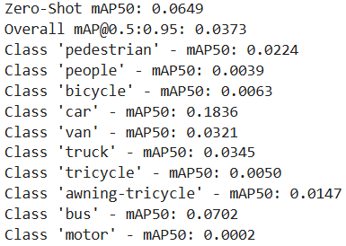
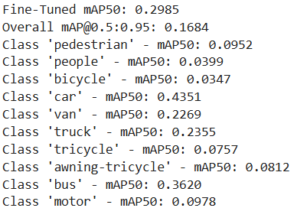
RESULT OF FINE TUNING
Zero shot
Fine tuning

Slide 26
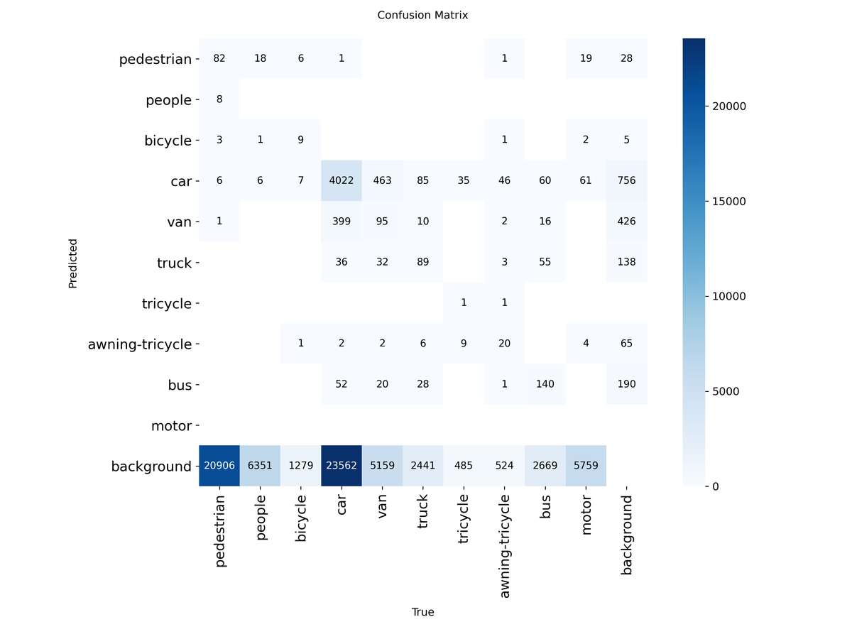
RESULT OF FINE TUNING
Zero shot

Slide 27
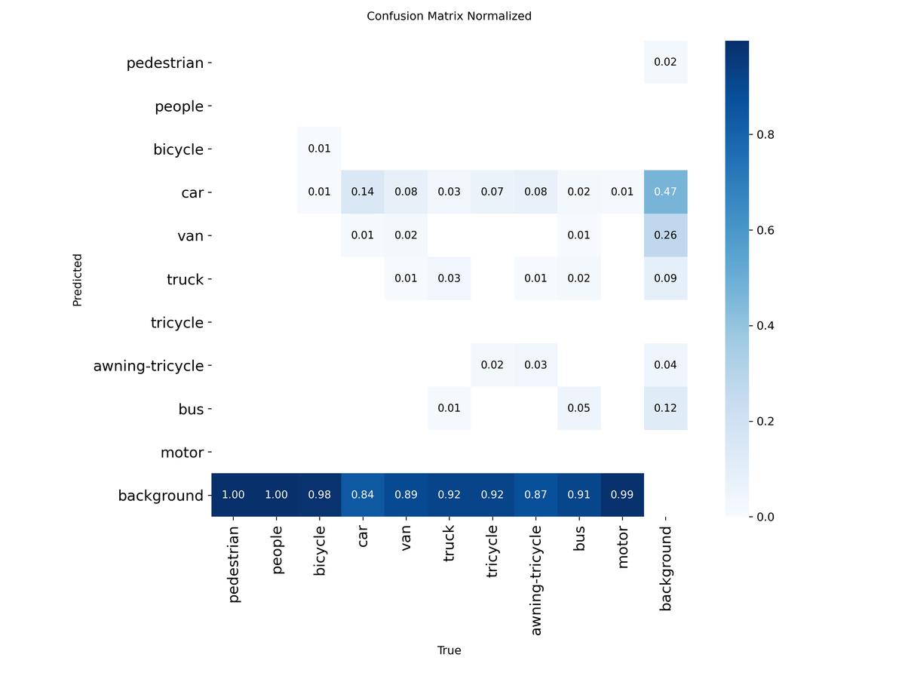
RESULT OF FINE TUNING
Zero shot

Slide 28
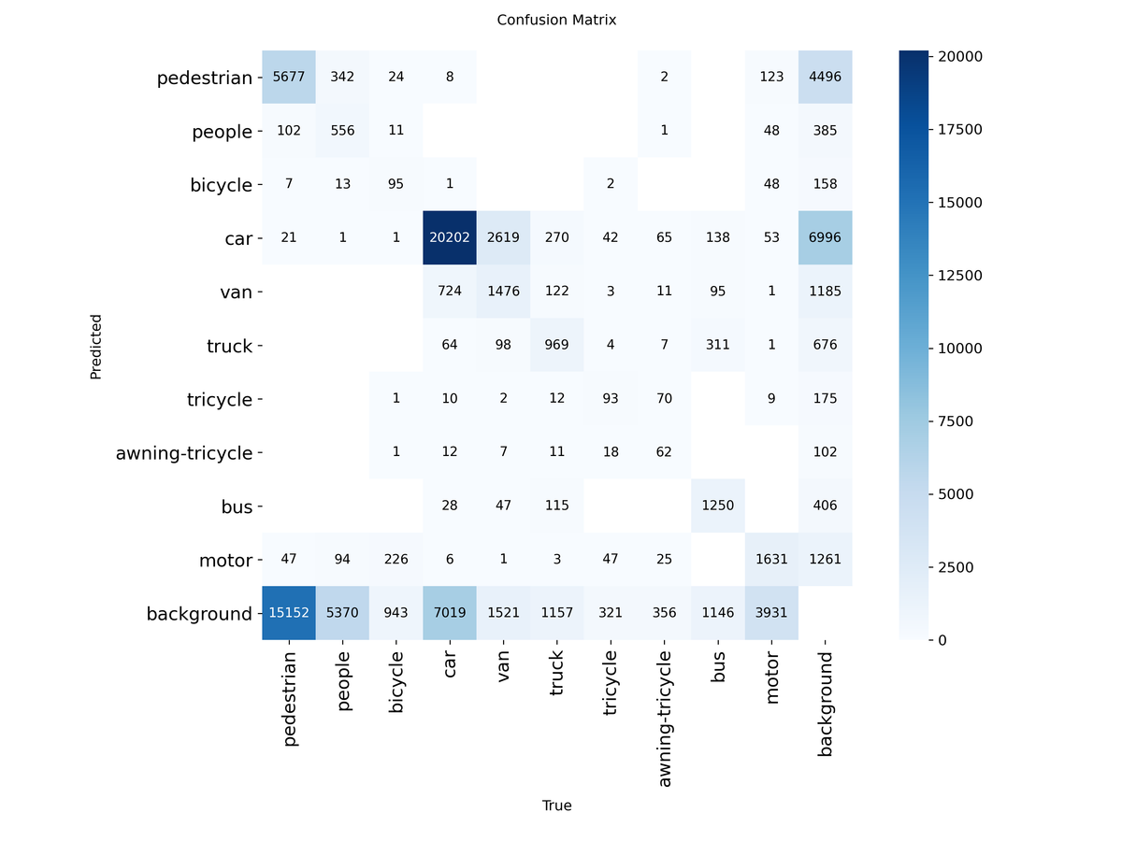
RESULT OF FINE TUNING
Fine tuning

Slide 29
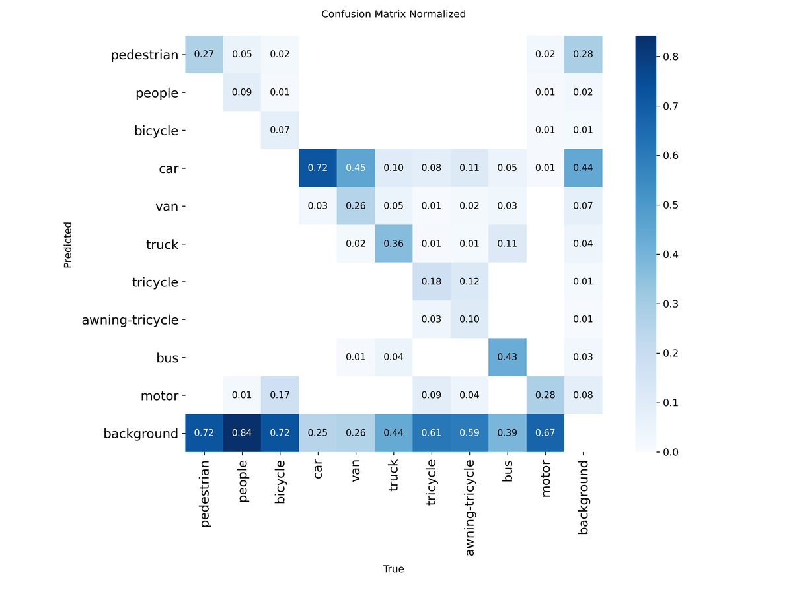
RESULT OF FINE TUNING
Fine tuning

Slide 30
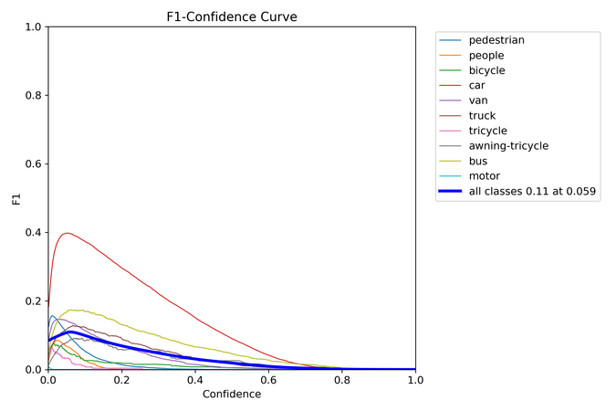
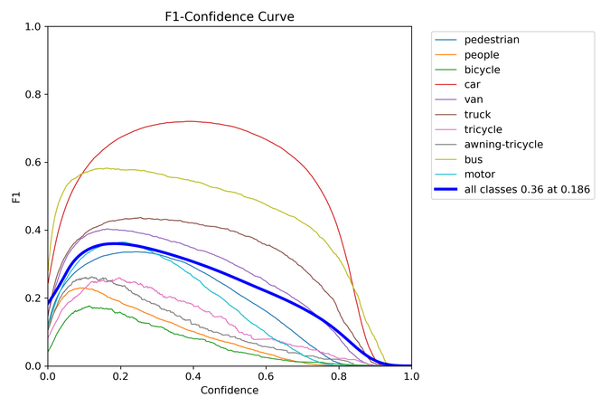
RESULT OF FINE TUNING
Zero shot
Fine tuning

Slide 31
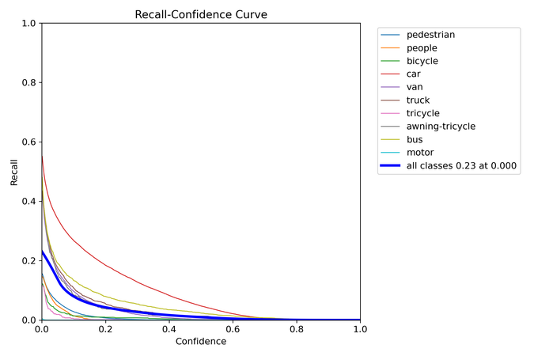
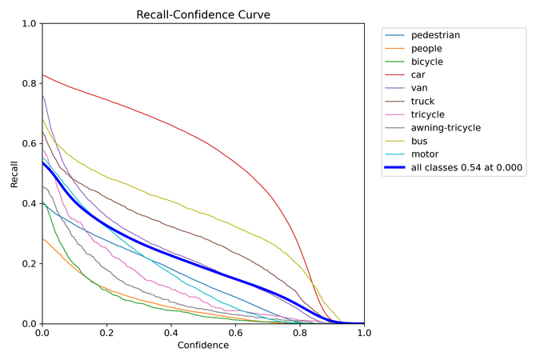
RESULT OF FINE TUNING
Zero shot
Fine tuning

Slide 32
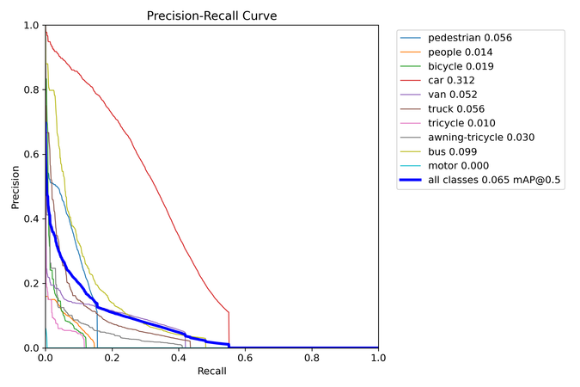
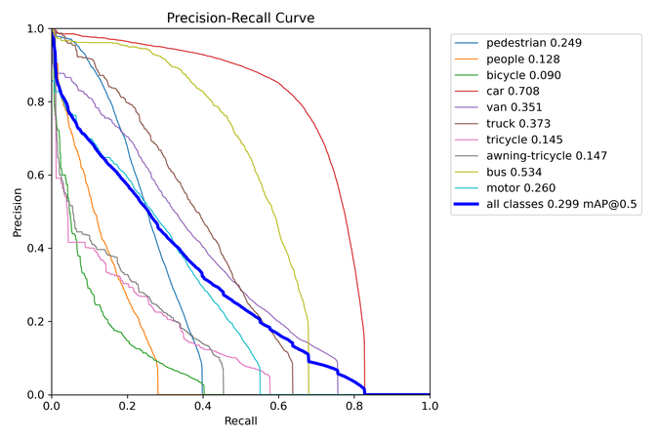
RESULT OF FINE TUNING
Zero shot
Fine tuning

Slide 33
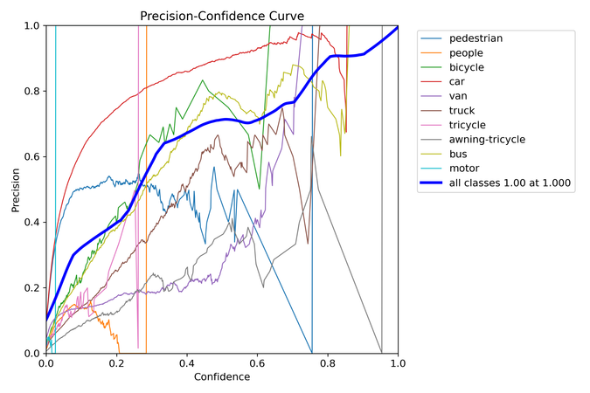
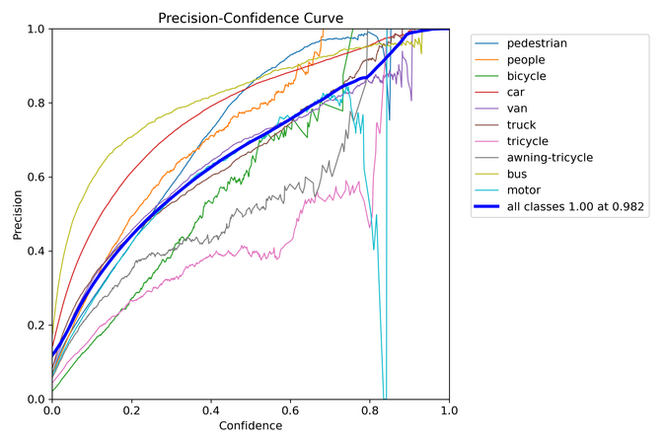
RESULT OF FINE TUNING
Zero shot
Fine tuning

Slide 34
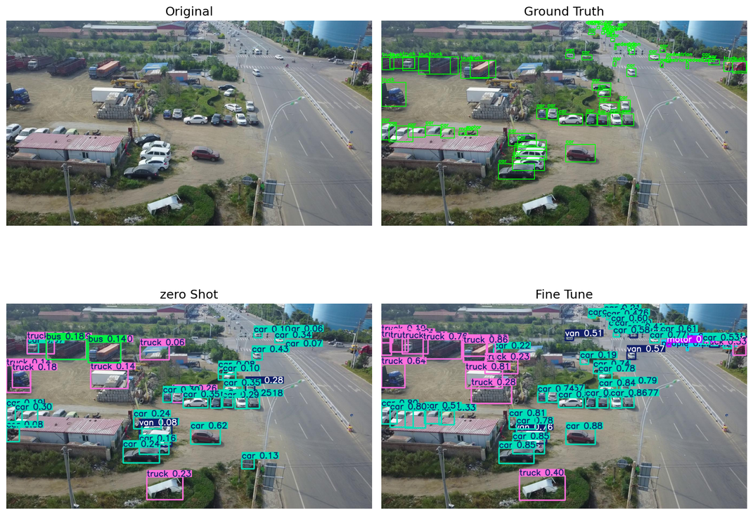
RESULT OF FINE TUNING

Slide 35
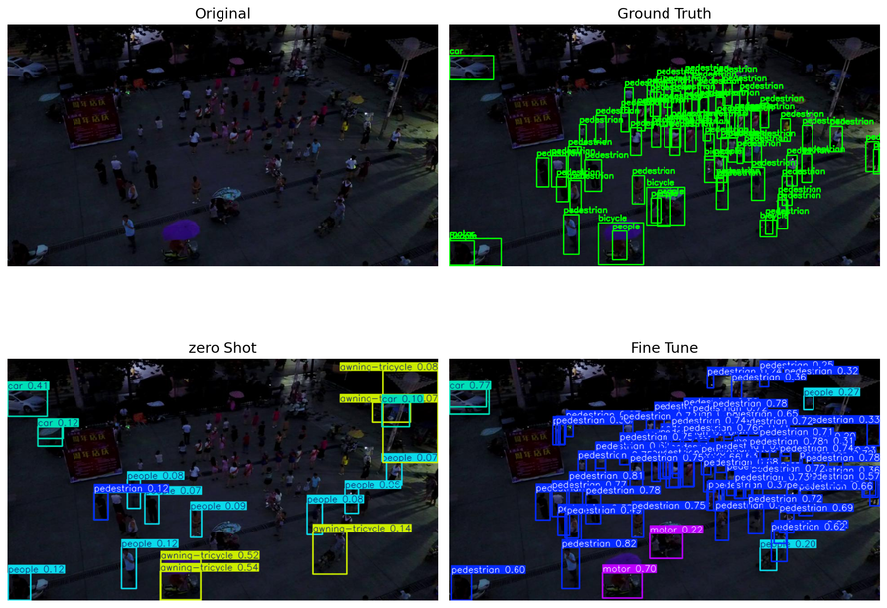
RESULT OF FINE TUNING

Slide 36
CHAPTER 4 : CONCLUSION
Performance on fine tuned version is still not good, possible reason:
  The dataset for train is not bigger enough (Not right, actually for fine tuning a train set with dimension 6500+ images is enough)
  The object in the images is too small( This is the principle problem)
  Some categories has sample number too small.
But the performance is creased after fine tuning, so the fine tuning is been considered as success.

Slide 37
FUTURE WORKS
It is possible to train from scratch a yolov8s model, which correspond to the yolov8s-worldv2 we used to fine tuning and zero shot test, and compare the YOLO model after train with the fine tuned YOLO-World.
A guess about result:
YOLO model and YOLO-World may get similar result, maybe the performance of YOLO is a little better than YOLO-World, but accuracy of YOLO-World is a little faster than YOLO, and as YOLO-World just asks 50-80 epochs to converge, and the YOLO requires more epochs.

Slide 38
FUTURE WORKS 2
BUT
The feasibility on current dataset is very low, because training a yolov8s model from scratch, 6500+ images is not enough.
If fine tune with a pretrained model of Ultralystic (trained with COCO dataset) is works( just retrain the last classification layer), but is different to the experiment done in the papers.
But still worth to try.

Slide 39
BIBLIOGRAPHY
Technique of YOLO-WORLD used:
https://github.com/ailab-cvc/yolo-world
https://github.com/ultralytics/ultralytics
Dataset of Visdrone
https://www.kaggle.com/datasets/kushagrapandya/visdrone-dataset
Paper of YOLO-World
https://arxiv.org/abs/2401.17270

Slide 40
THANK YOU

